Slide 1
CSCI 316 - Group Assignment
G-Score - #21
UOW ID | Name
8492591 | Basil Shibu
8465745 | Chandramohan Kishore
7894363 | Lim Wen Mi
7672755 | Harshitha Namasivayam
8950611 | Subraja Saravanakumar

Slide 2
Table of contents
01
02
03
04
05
Data Selection & Objective
Task 1
Task 2
Conclusion
References

Slide 3
01
Data Selection & Objective

Slide 4
Data Selection & Objective
Data Selection: Apartment Rent Data
Data Download from: https://www.kaggle.com/datasets/shashanks1202/apartment-rent-data
The dataset comprises the detailed information on apartment rentals for various machine learning tasks including clustering, classification and regression.
Our Objective
Using the following Python machine learning library to predict the rental price.
Task 1: Scikit-Learn
Task 2: Spark MLlib for ML task (non-ML libraries are allowed for non-ML tasks)
Notes:
Sub

Slide 5
Features in Dataset
Identifier
Geographic Details
Unique Identifiers (id)
Address
Cityname
State
Latitude
Longitude
Source of the classified listing
Property Details
Pricing Information
Apartment’s category
Title
Body
Amenities
No. of bathrooms
No.of bedrooms
Size of apartment (square_feet)
Rental price (price)
Displayed price (price_display)
Price in USD (price_type)
Fee
Notes:
Sub

Slide 6
Features in Dataset
Additional Features
Whether the apartment has a photo (has_photo)
Whether pets are allowed (pets_allowed)
Other relevant details:
- Currency
- Time of listing creation (in unix timestamp string)
Notes:
Sub

Slide 7
02
Task 1

Slide 8
About the Dataset
We downloaded the apartment rental dataset from KaggleHub. Then we opened the data file, making sure we read it correctly even if there were some small formatting issues, removed messy characters like extra spaces or line breaks from descriptions and got rid of a column that wasn't needed and made sure the price information was in a usable number format. We also removed any listings that didn't have a price.
We divided the data into two main groups: a 80% for Training our models and 20% for Testing how well they learned. We also removed some columns that wouldn't help in predicting the price, like the listing ID or exact address.
We figured out which pieces of information were numbers (like square feet or number of bedrooms) and which were categories (like the type of apartment or if pets are allowed).
We set up a system to get the data ready for the prediction models.
For numbers, we filled in any missing values with the average number and adjusted the numbers so they were on a similar scale. We also added a new calculated feature (like a ratio of bathrooms to bedrooms).
For categories, we filled in missing values with the most common category and converted the categories into a format the models could understand (like turning "Apartment" into a numerical representation).
So, in short, we downloaded the data, cleaned it up, transformed it, and then prepared it so that different prediction methods could learn from it and try to guess the rental price.

Slide 9
Preprocessing
Data Cleaning is done using different methods on different columns
Preprocesser is called in a pipeline to organise workflow
“pipe = Pipeline([ ('preprocessor', preprocessor)”
Remove columns -
price_display to prevent too much noise
Id,title and body are too unique to be useful
Handle missing data-
Numbers are filled in with median value
Text are filled in with value of higher frequency
Notes:
price _display is not useful for prediction-The price_display column is not useful because it's a form of data leakage. It's essentially a copy or a slightly different format of your target variable, price Id,title and body -These columns are not useful because they are either random identifiers or contain text that is too unique to each apartment. This makes them poor predictors for a general model
median is used as it is less sensitive to outliers
quare_feet might range from 500 to 3000.
bathrooms might range from 1 to 5.
To a machine learning model, a change of +500 in square_feet looks huge compared to a change of +1 in bathrooms. The model might mistakenly believe that square_feet is hundreds of times more important than bathrooms simply because its numbers are bigger.

Slide 10
Preprocessing
Convert all values to numeric format for machine learning model to understand
Scale numeric features using standard scaler
Convert values such as cityname using one-hot encoding
ColumnTransformer split the numeric value with the categorical values,
Which is then cleaned and merged back together.
“preprocessor = ColumnTransformer( transformers=[ ('num', numeric_transformer, num_features), ('cat', categorical_transformer, cat_features) ]”
x
Notes:
To prepare our data, we used a ColumnTransformer to automatically scale our numeric features and one-hot encode our text categories. This single step transformed our raw data into a clean, purely numerical format, ensuring it was consistent and ready for model training

Slide 11
3 Machine Learning Algorithms Chosen
Linear Regression
Decision Tree
Random Forest

Slide 12
Linear Regression
Concept: Assumes a direct, linear relationship between apartment features and rental price.
How it Works: It mathematically models price as a combination of weighted features, identifying the straight-line relationship that best fits the data.
Role in Task: Serves as an interpretable baseline to understand the fundamental impact of features on price.
Notes:
Gather data on the dependent and independent variables,fit linear equation to data,use linear equation to predict the data

Slide 13
2. Decision Tree
Concept: Makes predictions by recursively splitting the data based on feature values.
How it Works: It builds a tree structure where each step (node) is a decision based on a feature, leading to a predicted price at the end (leaf). This allows it to capture more intricate relationships than a simple linear model.
Role in Task: It helps uncover non-linear patterns and feature interactions that influence the price.

Slide 14
3. Random Forest
Concept: A collective method that combines predictions from multiple Decision Trees.
How it Works: It trains several Decision Trees on variations of the data and features, then averages their predictions to produce a final, more robust estimate.
Role in Task: Generally offers improved predictive accuracy and stability by reducing the risk of overfitting and capturing complex data structures effectively.

Slide 15
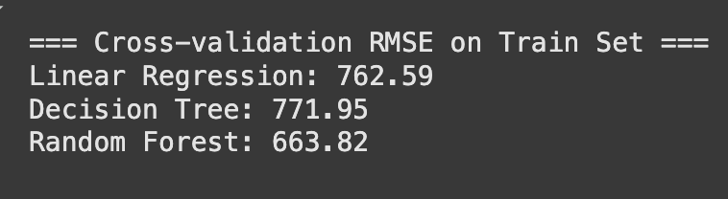
Metrics on Training Set

Slide 16
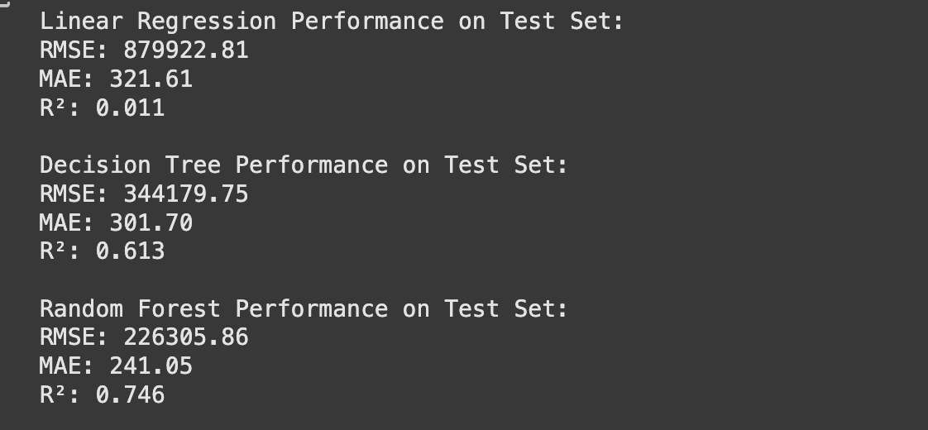
Final Metrics on Test Set
(as of 18 Aug 2025)

Slide 17
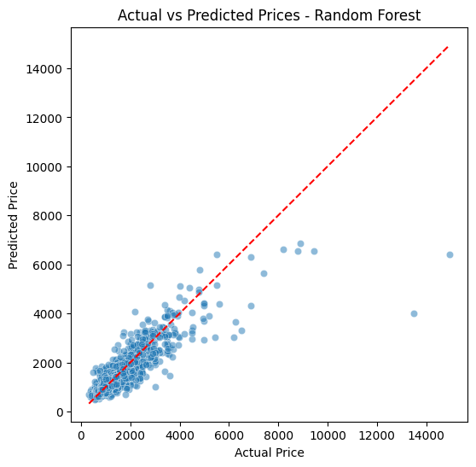
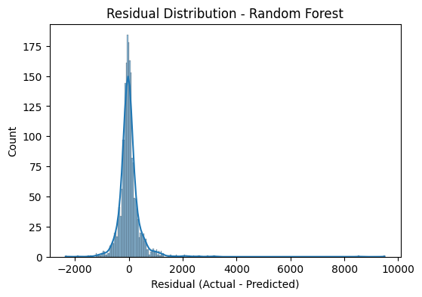
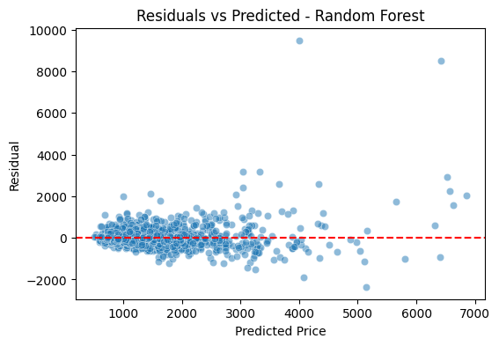
Graphs for Visualisations
(as of 18 Aug 2025)

Slide 18
How we approached Task 1
Our approach for Task 1 was centered around building, comparing and evaluating different models to predict apartment rental prices using the 10K - listing dataset. Here's the breakdown of the steps:
Data Preparation: We started by loading the dataset, cleaning it up (removing unnecessary text and formatting), and making sure the price information was ready to be used.
Splitting the Data: We divided the prepared data into a larger set for "training" our prediction models and a smaller set for "testing" how well they performed on new data.
Getting Data Ready for Models: We set up a process to transform the different types of information (numbers and categories) so that the models could understand them. This included filling in any gaps in the data and converting categories into a numerical format.
Building and Testing Models: We chose a few different prediction models (Linear Regression, Decision Tree, and Random Forest) and trained each one using the prepared training data.

Slide 19
How we approached Task 1 (cont’d)
Comparing Performance: After training, we used the test data to see how well each model predicted the prices. We looked at specific scores to measure their accuracy and figure out which model was the best at predicting prices for this dataset.
Fine-Tuning: For some of the better performing models (like Decision Tree and Random Forest), we tried adjusting some of their internal settings (hyperparameters) to see if we could make them even more accurate and execute faster as well.
Final Check: We evaluated the best versions of our models on the test data one last time and looked at some visualisations to understand how well they were doing and what factors were most important in their predictions.
Essentially, Task 1 was about taking the raw apartment data, getting it into a usable format, trying out different prediction methods, and finding the one that worked best for estimating rental prices.

Slide 20
03
Task 2
Notes:
Wen mi

Slide 21
03.1
Task 2
Data Loading
Notes:
Wen mi

Slide 22
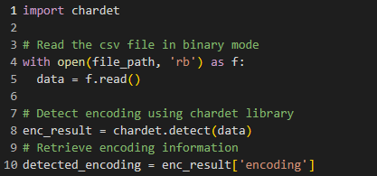
Detect File Encoder
`chardet` library used for detect the encoding of CSV file.
Notes:
Wen mi

Slide 23
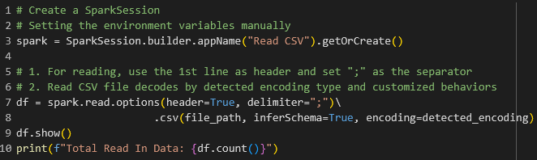
Data Loading
Reading the CSV File as `spark`
Notes:
Wen mi

Slide 24
03.2
Task 2
Data Pre-processing and Visualising
Notes:
Wen mi

Slide 25
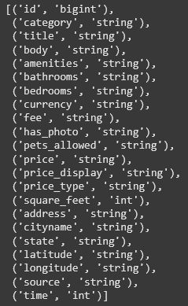
Verify DataTypes
`df.dtypes`
No. of bathrooms and bedrooms should be integer type
Price, latitude, longitude should be double type
Notes:
Wen mi

Slide 26
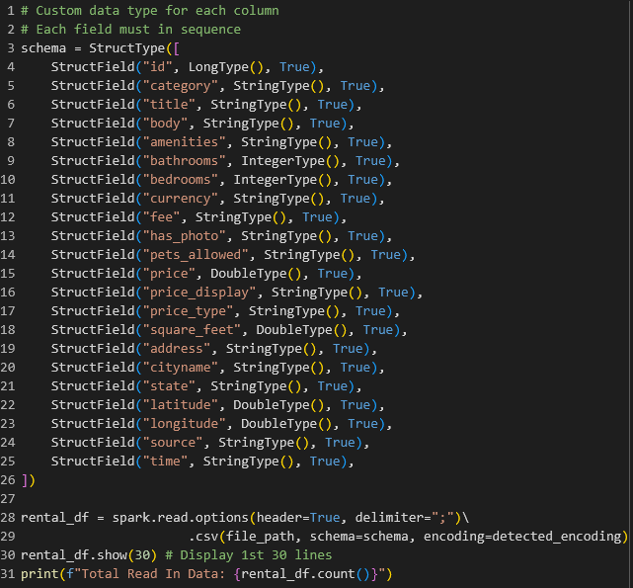
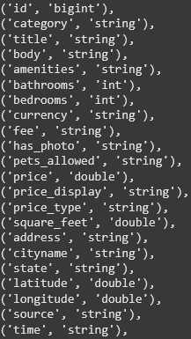
Custom DataType for Each Column
1
2
Notes:
Wen mi

Slide 27
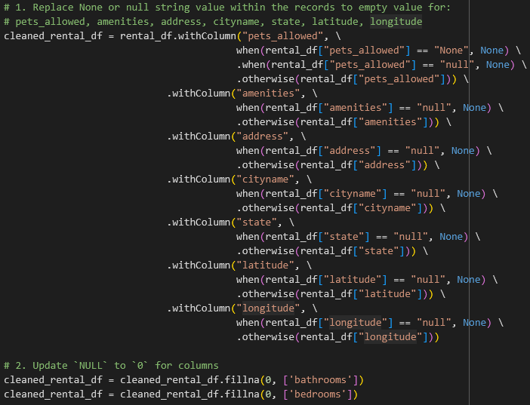
Set Empty Values to `NULL`
Notes:
Wen mi

Slide 28
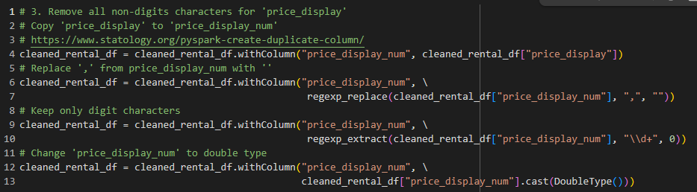
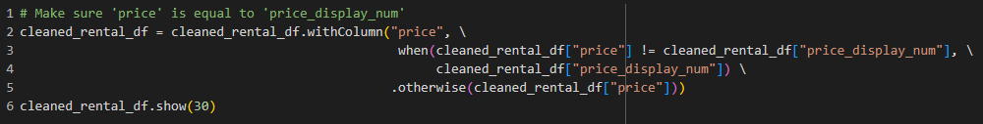
Make Sure No Noise From `price`
Clean the format of `price_display` => (e.g. $2,195 Weekly) for convert it to a double type in a new column
1
2
Notes:
Wen mi

Slide 29
Make Sure No Noise Data Row From Non Apartment Rent
Notes:
Wen mi

Slide 30
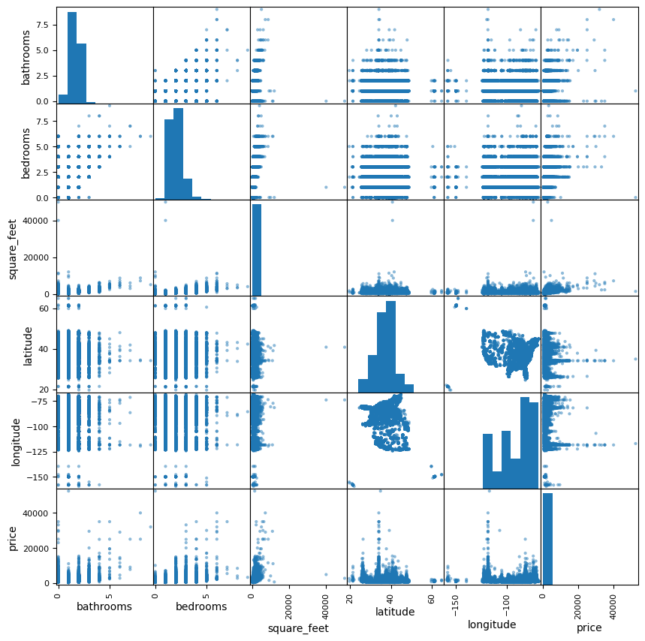
Plot Scatter Matrix for Numerical Features
bathrooms
bedrooms
square_feet
latitude
longitude
price
Notes:
Wen mi

Slide 31
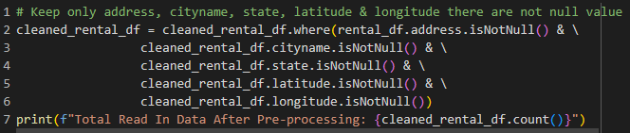
Remove Rows with Empty Geographic Details
Notes:
Wen mi

Slide 32
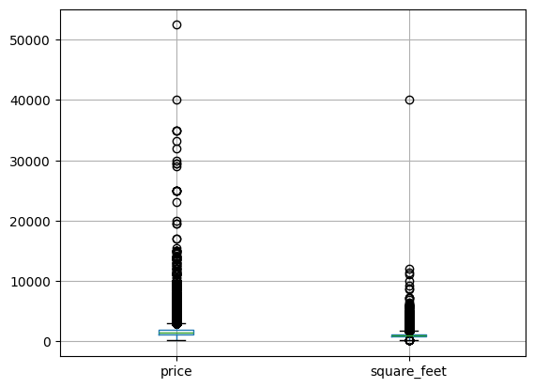
Plot boxplot() for Better Picture on Specific Fields
Notes:
Wen mi

Slide 33
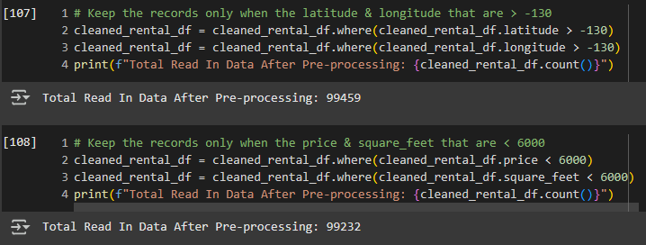
Remove Part of The Outliers
Notes:
Wen mi

Slide 34
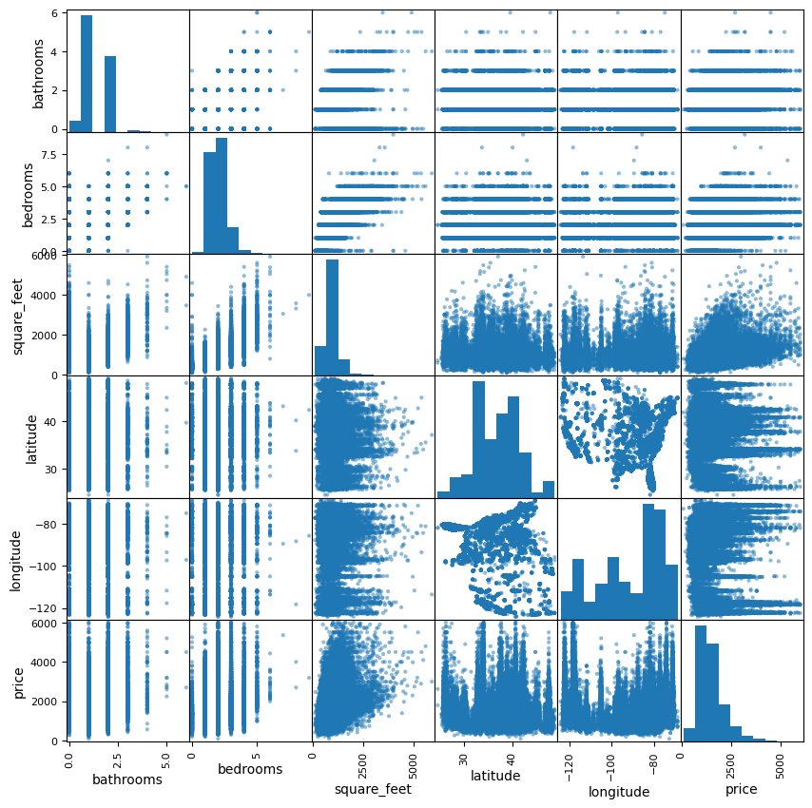
Original Scatter Matrix
Final Scatter Matrix
Notes:
Wen mi

Slide 35
03.3
Task 2
Transformation

Slide 36
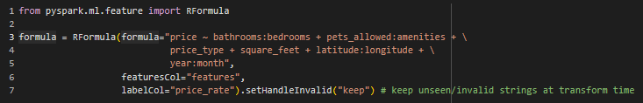
RFormula in Spark
A feature transformer that provides a concise way to specify a set of features and target variables using a R-like formula format.
Notes:
Wen mi
2 criterias:
All categorical columns iterated must contained at least 2 distinct value.
All numerical columns iterated must not contained empty value.
Symbols for the R-like formula:
`~` Separates the target from features (e.g. work as: =)
`+` Concatenate terms. If "+0", this will remove the intercept.
`-` Removes a term, "-1" will remove the intercept.
`:` Allow to create interactions between columns (e.g. y ~ a + b + a:b will correspond to y = w0 + (w1 x a) + (w2 x b) + (w3 x a x b), where the w's are coefficients)

Slide 37
03.4
Task 2
Data Splitting
randomSplit()
80% Training
20% Testing
Notes:
Har

Slide 38
03.5
Task 2
Model Training
Notes:
Har

Slide 39
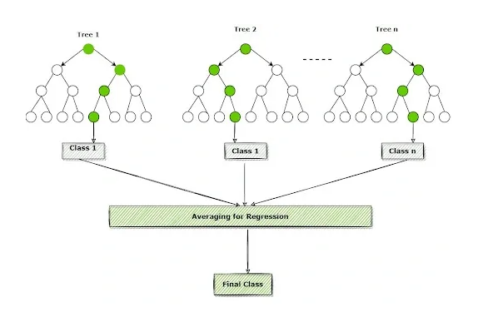
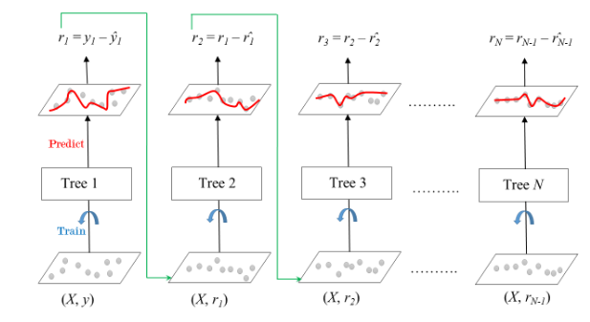
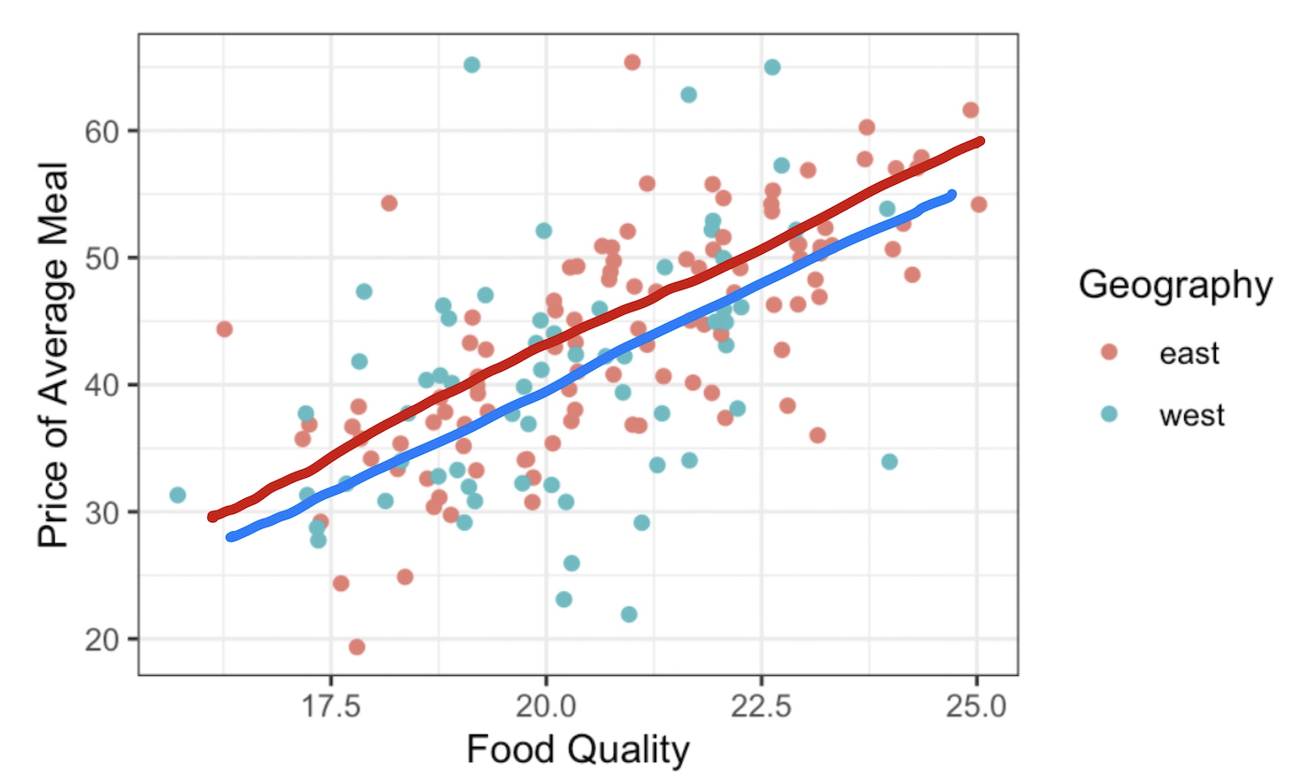
Models Selected
Random Forest Regression
Gradient-Boosted Tree Regression
Multiple Linear Regression
Notes:
Har

Slide 40
03.6
Task 2 - #1 Model
Random Forest Regression (RFR)
Notes:
Har

Slide 41
Random Forest Regressor is a popular model for supervised learning to predict continuous data (numerical values). It uses the predictions/results of multiple decision trees making it robust to overfitting and perform generalization (ability to do well with unseen data and not memorize the training data).
PySpark has a library to import the regressor model
Notes:
Har

Slide 42
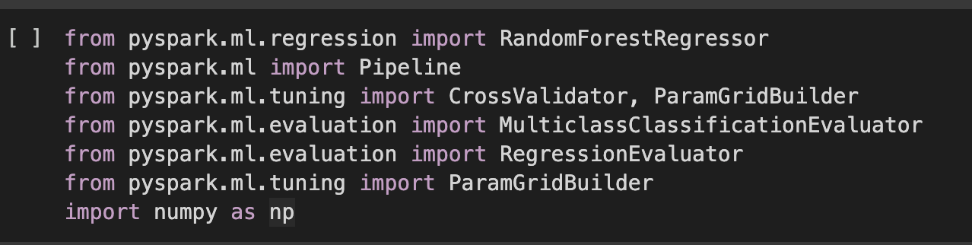
Libraries
We imported all the necessary libraries using pyspark.
Notes:
Har

Slide 43
Model object and pipeline
Creating (instantiating) a Random Forest Regressor object in PySpark ML and using a pipeline with the rformula created earlier.
Notes:
Har

Slide 44
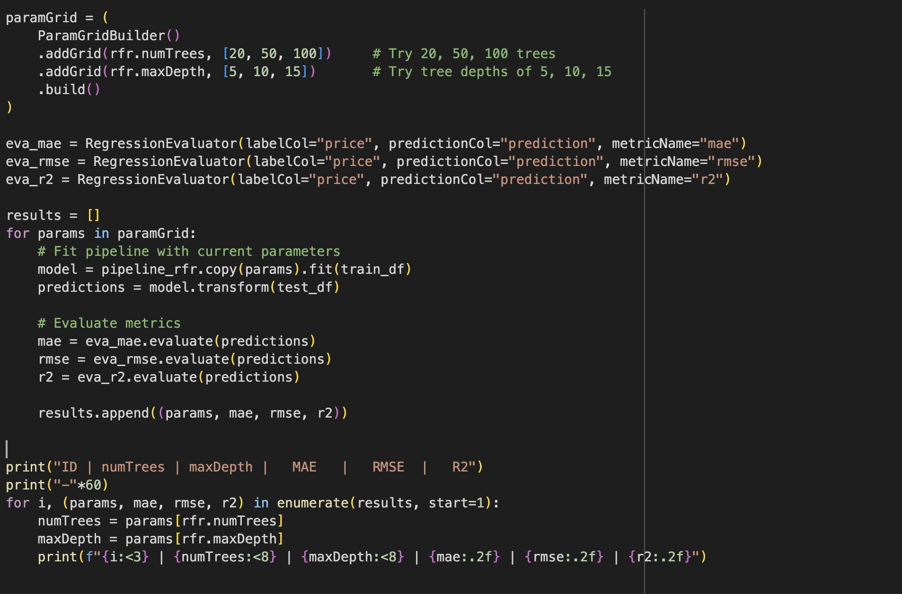
Hyperparameter
We use the ParamGridBuilder from pyspark to fine tune the hyperparameters
Notes:
Har

Slide 45
Hyperparameter
Evaluation metrics code
We use the ‘evaluate’ function from pyspark library on the evaluation metrics like MAE, RMSE and R^2 to find the best combination of hyperparameters that will best suit the model’s performance. That is, R^2 should be the greatest and the MAE and RMSE should be the lowest.
Notes:
Har

Slide 46
Hyperparameter
We store the results in the list called results.
Notes:
Har

Slide 47
Hyperparameter
Printing out the evaluation metrics results in a tabular format
Notes:
Har

Slide 48
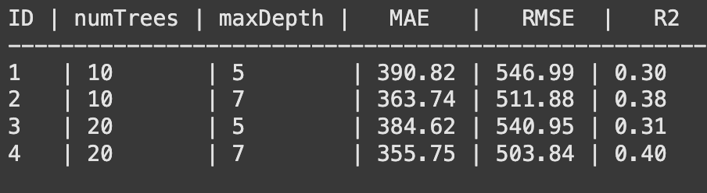
Hyperparameter
Selection of the best hyperparameter:
MAE & RMSE : lowest value
R^2 : highest value
Notes:
Har

Slide 49
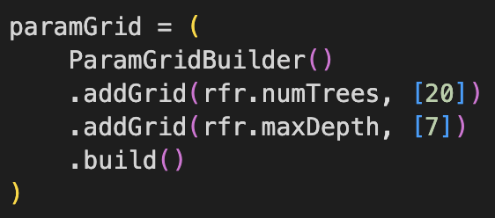
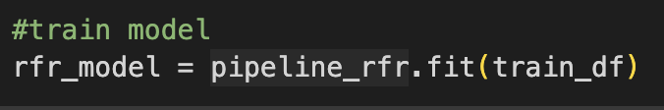
Train Model
We use the chosen optimal combination of hyperparamter and train the model
Notes:
Har

Slide 50
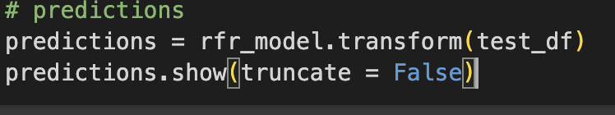
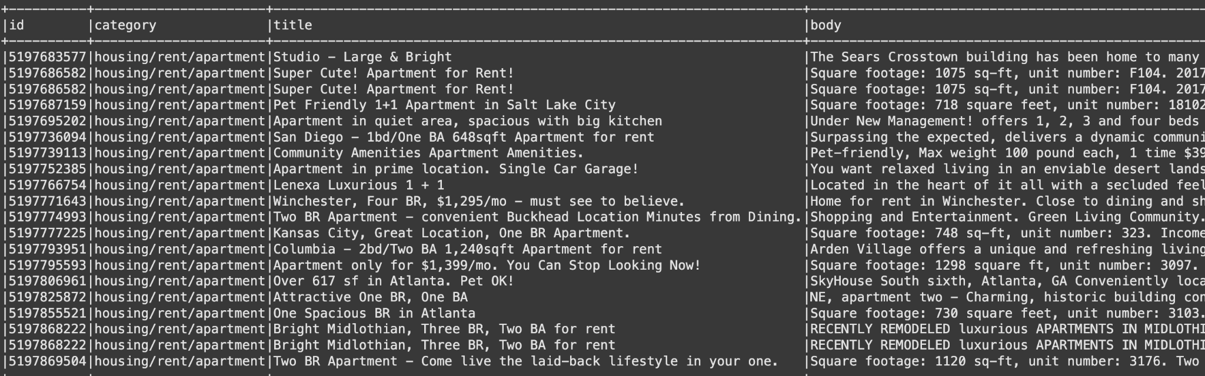
Prediction
Prediction by the model using test data
Notes:
Har

Slide 51
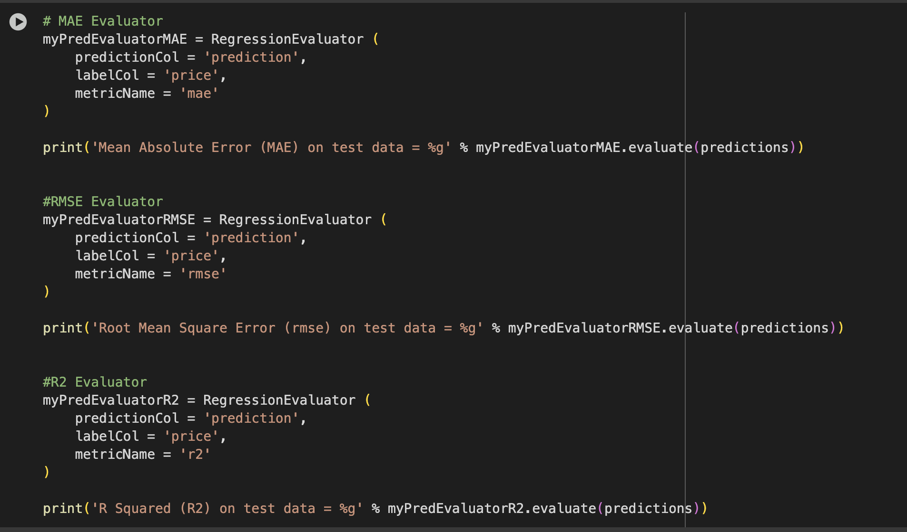
Evaluation metrics code
Notes:
Har

Slide 52
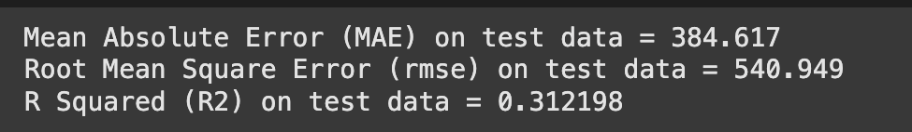
Evaluation Metrics
The Mean Absolute Error
Root Mean Squared Error
Coefficient of Determination (often just called R-squared)
Notes:
Har

Slide 53
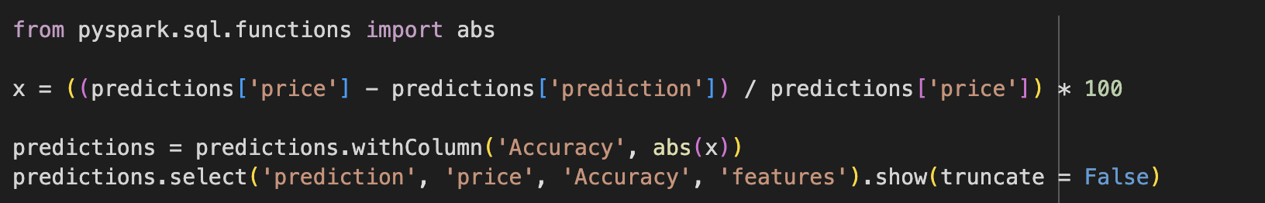
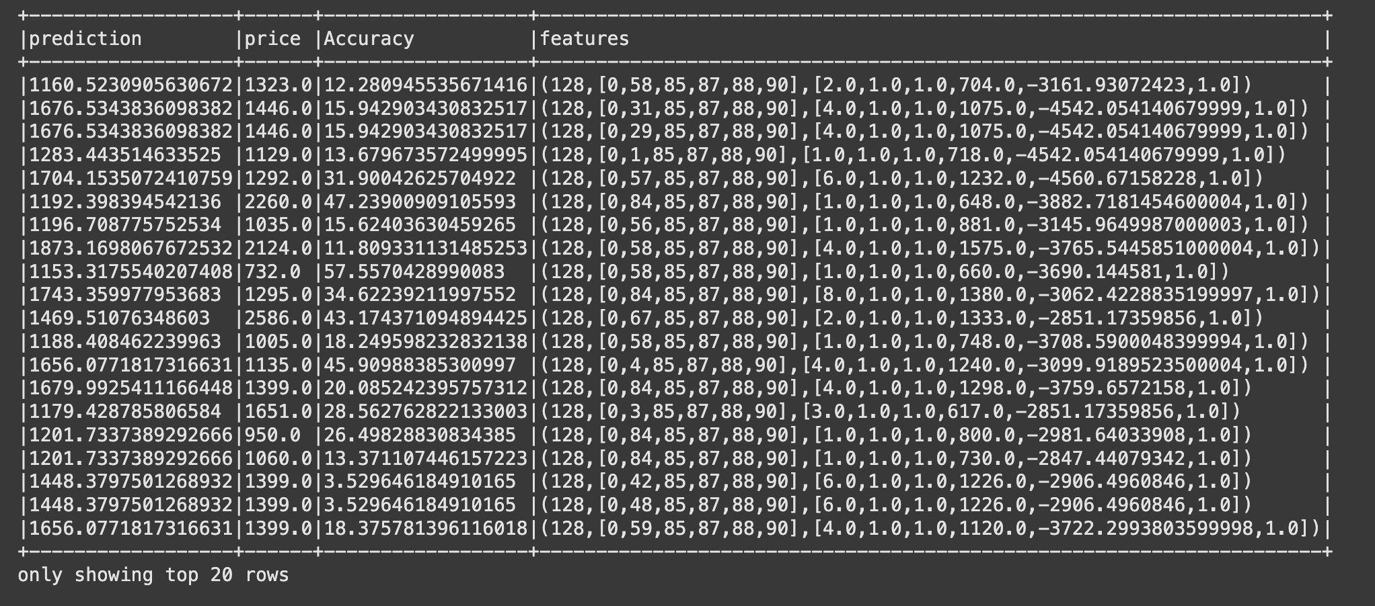
Accuracy of the model
Notes:
Har

Slide 54
03.7
Task 2 - #2 Model
(GBT)
Gradient-Boosted Tree Regression
Notes:
wm

Slide 55
Gradient-Boosted Tree Regression
Work as sequentially training models
Each new model is trained to minimize the loss function such as mean squared error of the previous models
Notes:
wm

Slide 56
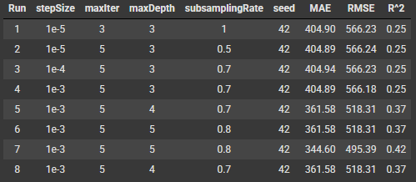
GBT Fine Tuning
Learning rate (stepSize) | Scales the contribution of each tree
No.of Tree (maxIter) | Controls the no.of tree to build
Max Depth (maxDepth) | Control the no.of levels in each decision tree
Subsampling Rate (subsamplingRate) | Controls the proportion of the data used to train each tree
Random Seed Values (seed) | Ensures that the model’s training process to produce the same result for each execution
Notes:
wm

Slide 57
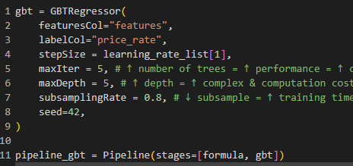

GBT Model Training
Notes:
wm

Slide 58
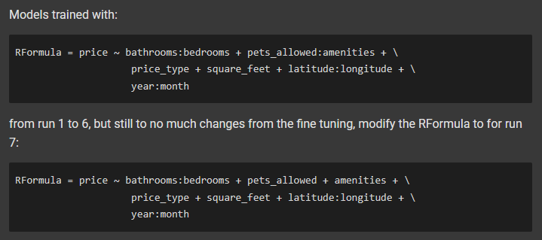
GBT Model Training
Notes:
wm

Slide 59
03.8
Task 2 - #3 Model
(MLR)
Multiple Linear Regression
Notes:
sub

Slide 60
Linear regression models the relationship between a dependent variable and a single independent variable by fitting a linear equation to the data.
Multiple Linear Regression models the relationship between a dependent variable and two or more independent variables.
WHAT IS THE DIFFERENCE?
Notes:
sub

Slide 61
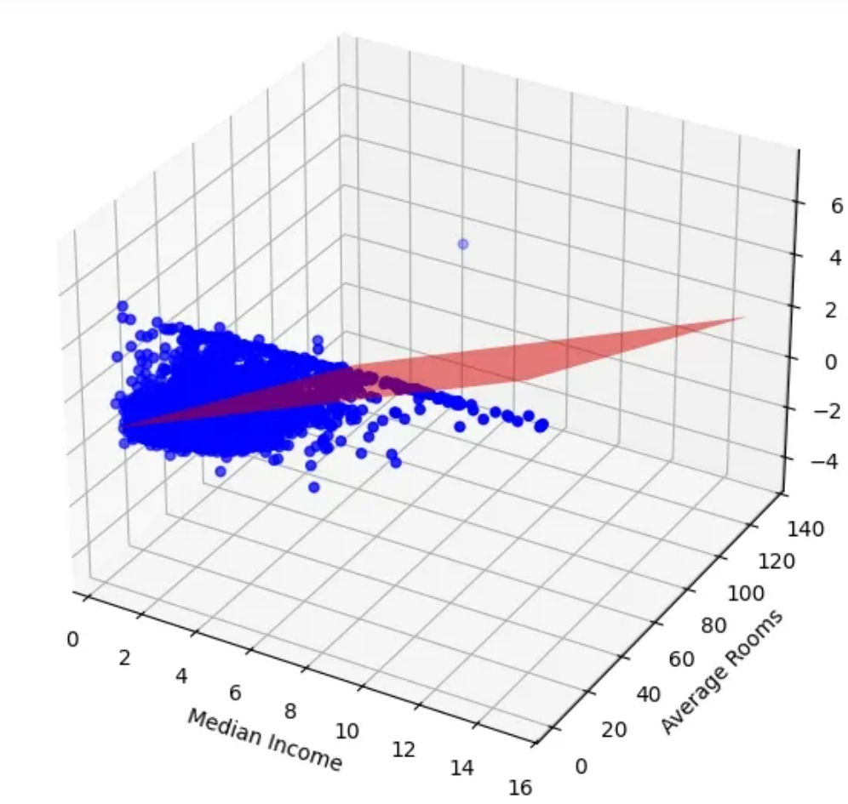
Why choose multiple linear regression?
It effectively captures how several factors together influence a target variable which helps in providing a practical approach for predictive modeling in real-world scenarios.
In our case, it enables us to interpret and regularise the linear form to let us quantify the predictor variables ( bedrooms, bathrooms, square-feet, amenities, price_type etc.) , while giving a fast, reproducible baseline to compare with tree models.
Notes:
sub

Slide 62
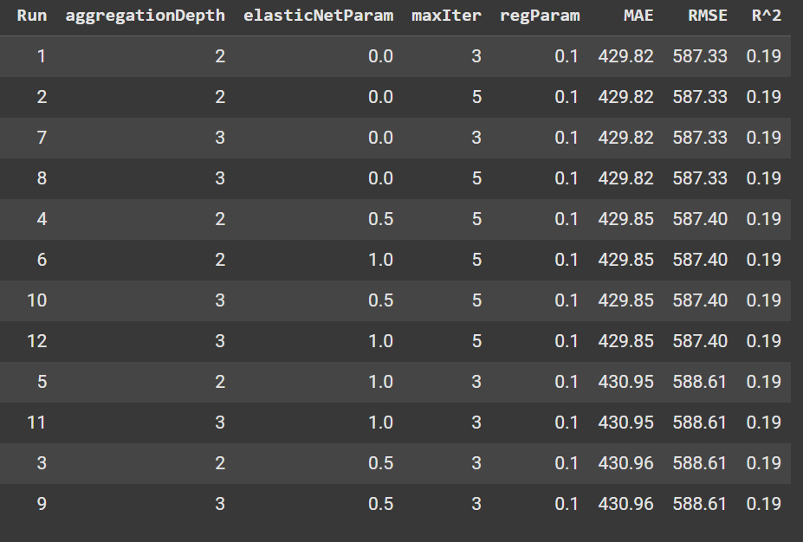
MLR Fine Tuning
Elastic Net mix (elasticNetParam) | How much L1 vs L2 regularization to use
Max iterations (maxIter) | Maximum Optimizer steps
Aggregation depth (aggregationDepth) | Tree depth for distributed aggregations
Regularization strength (regParam) | Overall penalty size λ applied to coefficients
Notes:
sub

Slide 63
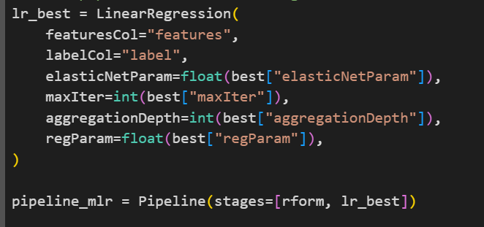
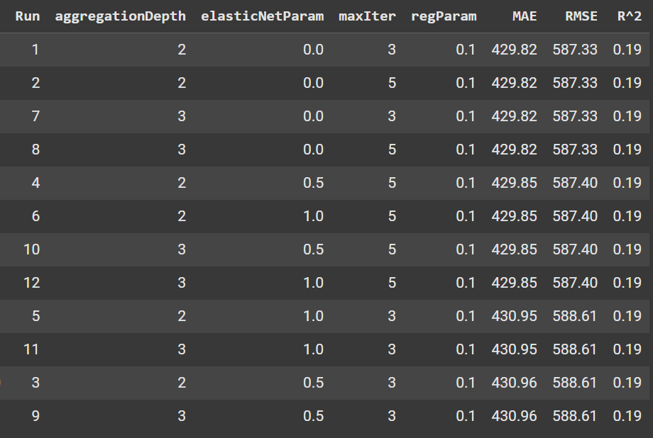

MLR Model Training
Notes:
sub

Slide 64
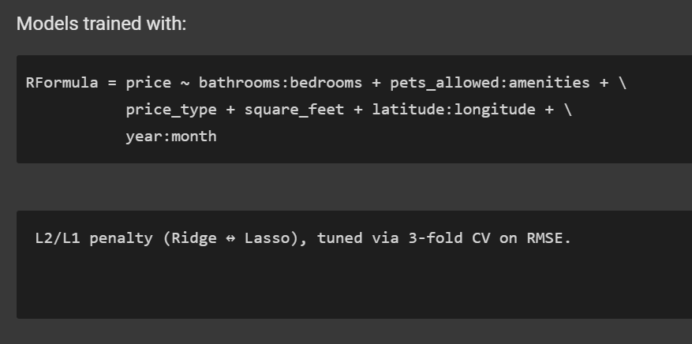
MLR Model Training
Notes:
sub

Slide 65
03.9
Task 2
Models Evaluation & Comparison
Notes:
Harshita

Slide 66



Determination Metrics to Evaluate the Performance
Mean Absolute Error
Root Mean Squared Error
Root-Squared (R^2)
Measures the average of the residuals in the dataset.
`RegressionEvaluator(labelCol = 'price_rate', metricName = 'mae')`
Measures the standard deviation of residuals.
`RegressionEvaluator(labelCol = 'price_rate', metricName = 'rmse')`
Represents the proportion of the variance in the dependent variable
`RegressionEvaluator(labelCol = 'price_rate', metricName = 'r2')`
Notes:
Harshita

Slide 67
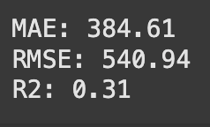




Comparison of the models’ performance
Random Forest Regression
Gradient-Boosted Tree Regression
Multiple Linear Regression
The lower value of MAE and RMSE implies higher accuracy of a regression model. However a higher value of R^2 is considered desirable.
Notes:
Harshita

Slide 68
Comparison of the models’ performance
From our observation of the evaluation metrics, Gradient-Boosted Tree Regression seems to be more robust.

Slide 69
04
Conclusion
Notes:
Basil and Kishore

Slide 70
Conclusion Comparison Report: Spark MLlib vs Scikit-Learn
Scalability and performance wise:
Scikit-Learn
Best suited for small to medium datasets that fit in the memory (RAM) of a single machine.
In-memory computations are fast for these dataset sizes.
Struggles or becomes unusable with very large datasets that don’t fit into local memory.
Spark MLib
Designed for distributed large-scale data processing.
Can handle datasets that are too large for a single machine, by distributing data and computation across a cluster of servers.
Adds cluster and cluster management overhead making it slower and more complex for small datasets
Notes:
Basil and Kishore

Slide 71
Conclusion Comparison Report: Spark MLlib vs Scikit-Learn
Usability and Flexibility
Scikit-Learn
Strong, simple and intuitive with imports and syntaxes
Has a strong integration with pandas and numpy for data preparation manipulation
Spark MLib
Less intuitive for if you are used to pandas and numpy syntaxes.
Is strongly based on Spark DataFrames and Pipelines.
It has both Python and Scala interfaces, but Python (PySpark) can have more overhead
Notes:
Basil and Kishore

Slide 72
Conclusion Comparison Report: Spark MLlib vs Scikit-Learn
Feature set and model coverage
Scikit-Learn
Offers a broader set of algorithms and preprocessing techniques.
Frequent updates, state-of-the-art methods, and advanced hyperparameter tuning.
Deep support for pipelines, feature selection, cross-validation, metrics, and model introspection
Spark MLib
Covers main Machine Learning algorithms (such as linear models, tree-based models, clustering, recommenders, etc.).
Fewer model options, less parameter fine-tuning, and usually lags behind sklearn in adopting new methods.
Pipelines and feature engineering tools focus on distributed processing.
Notes:
Basil and Kishore

Slide 73
Conclusion Comparison Report: Spark MLlib vs Scikit-Learn
Integration and ecosystem
Scikit-Learn
Has Easy integration with pandas, matplotlib, seaborn, ensorFlow, PyTorch, and most of the Python data ecosystem.
Spark MLib
Tight integration with the full Spark ecosystem (Spark SQL, streaming, graph, etc.)
Often used as part of larger ETL/data engineering workflows.
Notes:
Basil and Kishore

Slide 74
Conclusion Comparison Report: Spark MLlib vs Scikit-Learn
Model training, debugging and evaluation
Scikit-Learn
Easier for quick prototyping, debugging, interpreting results, and experimenting.
Model evaluation and transformation are straightforward.
Subject to dataset size, the larger the dataset the more time it might take to run the Machine learning algorithms
Spark MLib
More boilerplate and less visibility into internals.
Debugging can be harder due to distributed nature, especially when errors occur across many nodes. It’s a tough challenge.
Good for production on very large/streaming data, but not for exploratory/statistical work.
Notes:
Basil and Kishore

Slide 75
Conclusion Summary of Comparison Report: Spark MLlib vs Scikit-Learn
Use Scikit-Learn when your data fits on one machine, you want rapid prototyping, interpretability, and access to the latest ML innovations.
Use Spark MLlib when your dataset is very large, distributed data processing is required, or you’re embedding ML into a Spark-based ETL or big data workflow.
For many real-world projects, teams might prototype models in Scikit-Learn and move only necessary production code to Spark MLlib when scaling is required.
Notes:
Basil and Kishore

Slide 76
Thank You!

Slide 77
References
https://medium.com/@wl8380/how-to-mount-google-drive-in-google-colab-c688ec8eccb7
https://spark.apache.org/docs/latest/sql-data-sources-csv.html
https://www.geeksforgeeks.org/python/detect-encoding-of-csv-file-in-python
https://www.geeksforgeeks.org/computer-science-fundamentals/reading-rows-from-a-csv-file-in-python/
https://sparkbyexamples.com/pyspark/how-to-import-pyspark-in-python-script
https://www.datacamp.com/tutorial/pyspark-read-csv
https://spark.apache.org/docs/latest/sql-data-sources-csv.html
https://www.datacamp.com/tutorial/pyspark-read-csv
https://spark.apache.org/docs/latest/sql-ref-datatypes.html
https://sparkbyexamples.com/pyspark/pyspark-update-a-column-with-value/
https://sparkbyexamples.com/pyspark/pyspark-fillna-fill-replace-null-values

Slide 78
References
https://stackoverflow.com/questions/56160196/how-to-extract-the-numeric-part-from-a-string-column-in-spark
https://www.geeksforgeeks.org/data-science/pair-plots-using-scatter-matrix-in-pandas/
https://stackoverflow.com/questions/50958721/convert-a-spark-dataframe-to-pandas-df
https://www.statology.org/pyspark-select-rows-based-on-column-values/
https://www.geeksforgeeks.org/python/how-to-create-boxplot-from-pandas-dataframe/
https://www.geeksforgeeks.org/python/drop-rows-in-pyspark-dataframe-with-condition/
https://spark.apache.org/docs/latest/api/python/reference/api/pyspark.ml.feature.RFormula.htm
https://community.getorchestra.io/apache-foundation/apache-spark-java-api-rformula/
https://www.geeksforgeeks.org/python/spark-split-array-to-separate-column/
https://spark.apache.org/docs/latest/api/python/reference/pyspark.sql/functions.html#array-functions

Slide 79
References
https://medium.com/@shuklaprashant9264/iterate-over-elements-of-array-column-in-pyspark-dataframe-6ec92467d3e4
https://spark.apache.org/docs/latest/api/python/reference/pyspark.sql/api/pyspark.sql.functions.explode_outer.html#pyspark.sql.functions.explode_outer
https://antonhaugen.medium.com/feature-selection-with-pyspark-a172d214f0b7
https://www.statology.org/pyspark-train-test-split/
https://sparkbyexamples.com/pyspark/pyspark-count-distinct-from-dataframe/
https://www.statology.org/pyspark-count-null-values/
https://www.geeksforgeeks.org/machine-learning/ml-gradient-boosting/
https://www.geeksforgeeks.org/machine-learning/gradient-descent-algorithm-and-its-variants/
https://www.datacamp.com/tutorial/guide-to-the-gradient-boosting-algorithm
https://spark.apache.org/docs/latest/api/python/reference/api/pyspark.ml.classification.GBTClassifier.html

Slide 80
References
https://www.machinelearningplus.com/pyspark/pyspark-gradient-boosting-model/
https://medium.com/analytics-vidhya/mae-mse-rmse-coefficient-of-determination-adjusted-r-squared-which-metric-is-better-cd0326a5697e
https://www.geeksforgeeks.org/machine-learning/ml-linear-regression/
https://www.geeksforgeeks.org/machine-learning/ml-multiple-linear-regression-using-python/
https://en.wikipedia.org/wiki/Tikhonov_regularization
https://en.wikipedia.org/wiki/Lasso_(statistics))
https://spark.apache.org/docs/latest/ml-classification-regression.html#linear-regression
https://www.meegle.com/en_us/topics/fine-tuning/fine-tuning-for-linear-regression
https://spark.apache.org/docs/latest/api/python/reference/api/pyspark.ml.regression.LinearRegression.html#pyspark.ml.regression.LinearRegression.maxIter
https://spark.apache.org/docs/latest/ml-classification-regression.html#linear-regression

Slide 81
References
ttps://www.geeksforgeeks.org/machine-learning/ml-multiple-linear-regression-using-python/

